Slide 1
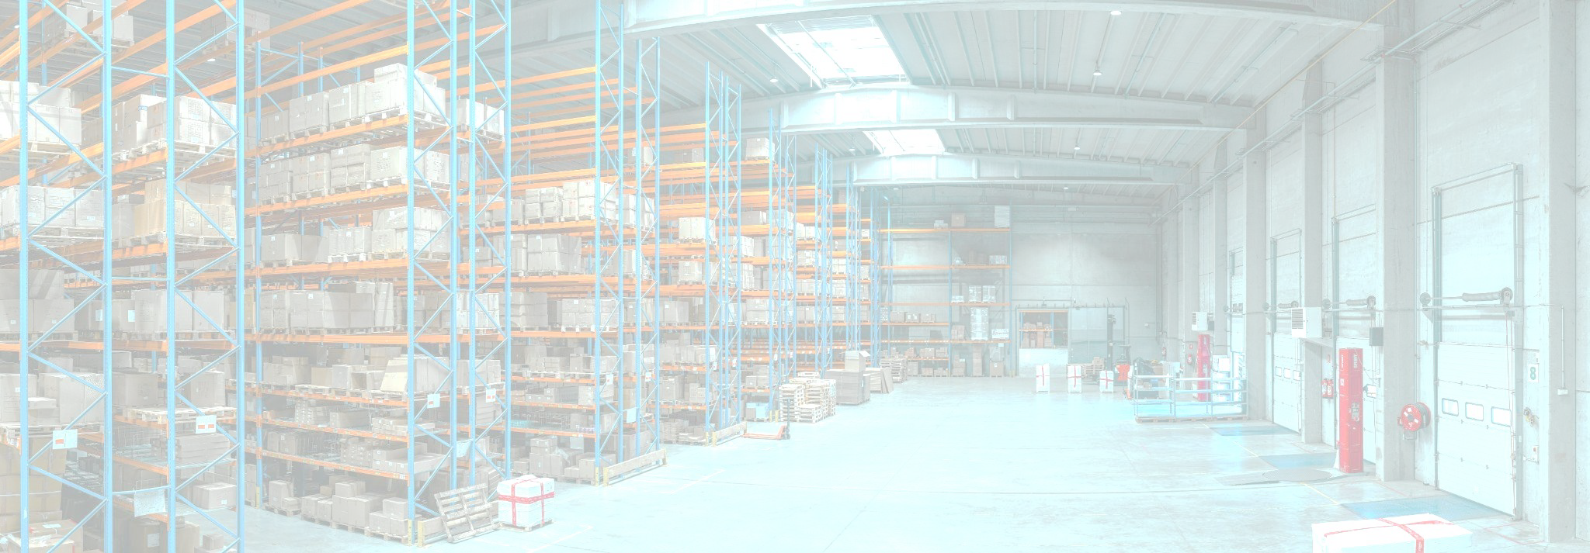
Late Delivery Risk
Analysis
Andhyka Cakrabuana Adhitama

Slide 2
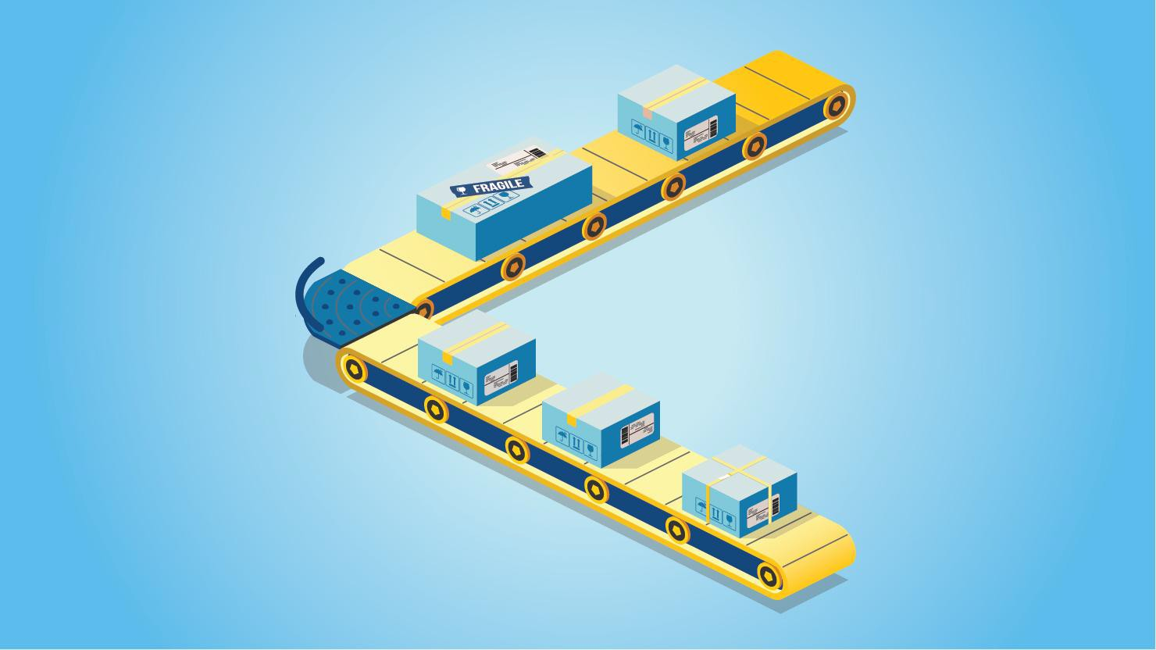
Business Overview
Exposed to the wave of the Covid-19 pandemic, the marketplace industry experienced an exponential surge in sales. The hashtag #dirumahaja one of the triggers that ultimately encourages people to shop online, which ultimately brings beneﬁts to certain lines of business, one of which is a third-party logistics service provider (Third Party Logistics). Competition among logistics service providers is heating up, new start-ups are emerging to answer the needs of order fulﬁllment services. After the pandemic subsided, the competition between logistics companies ﬁnally tried to offer various new beneﬁts to support changes in business models for customers. B2B services to deal with customers who increasingly want to shop in ofﬂine stores, cooperation with several delivery service providers, and of course, increase order fulﬁllment speed. Through this analysis, the authors hope to exchange ideas regarding what are the factors that inﬂuence the delay in order fulﬁllment using machine learning models.

Slide 3
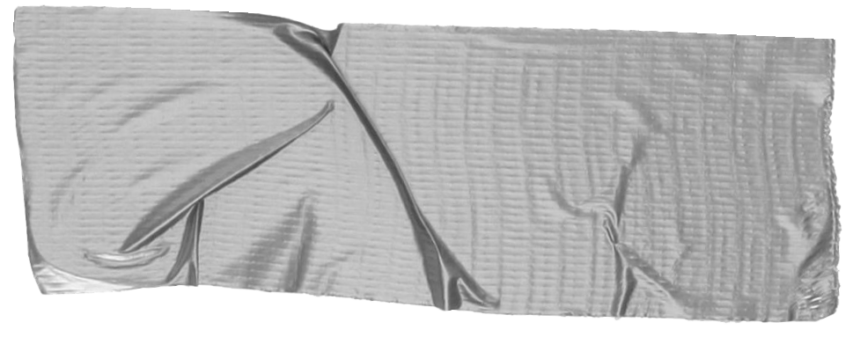

Problems
Steps
Late Delivery Risk factor.
What aﬀects the level
fulﬁllment speed, as well as the characteristics of orders that can trigger the emergence of late delivery risk.
Recommendation
What are the recommendations and improvised strategies that can increase the speed of order fulﬁllment and the preventive measures that can be taken to deal with delays.
Data Preparation & Proﬁling
Exploratory Data Analysis
Preprocessing
Modeling Preparation
Modelling
Recommendation
of order

Slide 4

DataCo Smart Supply Chain for Big Data Analytics
Numpy, Pandas, Matplotlib, Seaborn, Sklearn, Dalex
2 Columns have
155.679 &
180.519 rows of null data, and mostly columns have high cardinality.
Data Proﬁle
Selection
Data has :
- 180.519 rows
53 columns
- 14 Int64
15 Float64
24 Object
For Late Delivery Risk analysis, we will use columns Late_delivery_risk
, Category Name,
Python Library
Null Data & Cardinality
Market, City, Country,
Order Order Order
Item Quantity,
Order Region, Shipping Mode.

Slide 5
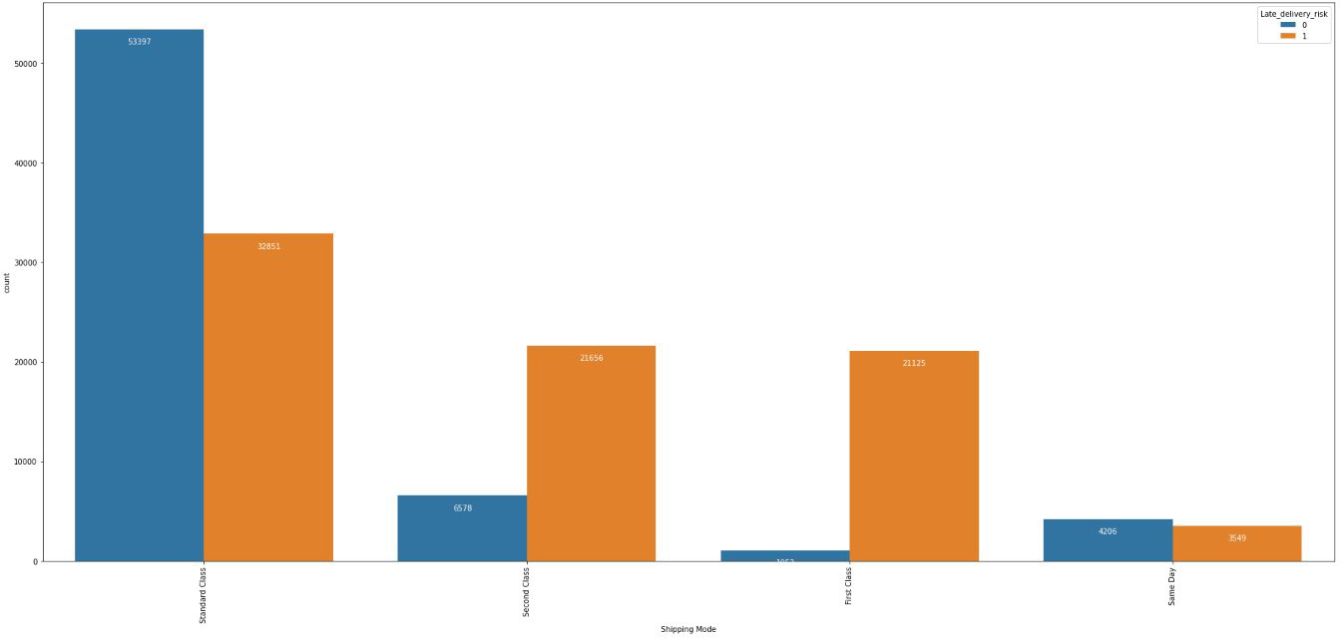
Shipping Modes do matter!
From the plot, we know that Shipping Modes can really determine in which late delivery risk more often to occur. As we can see the shipping mode that lowest chance to be over SLA is Standard Class and Same Day, however we could see that Same Day service have almost 50:50 chance for late delivery service.

Slide 6
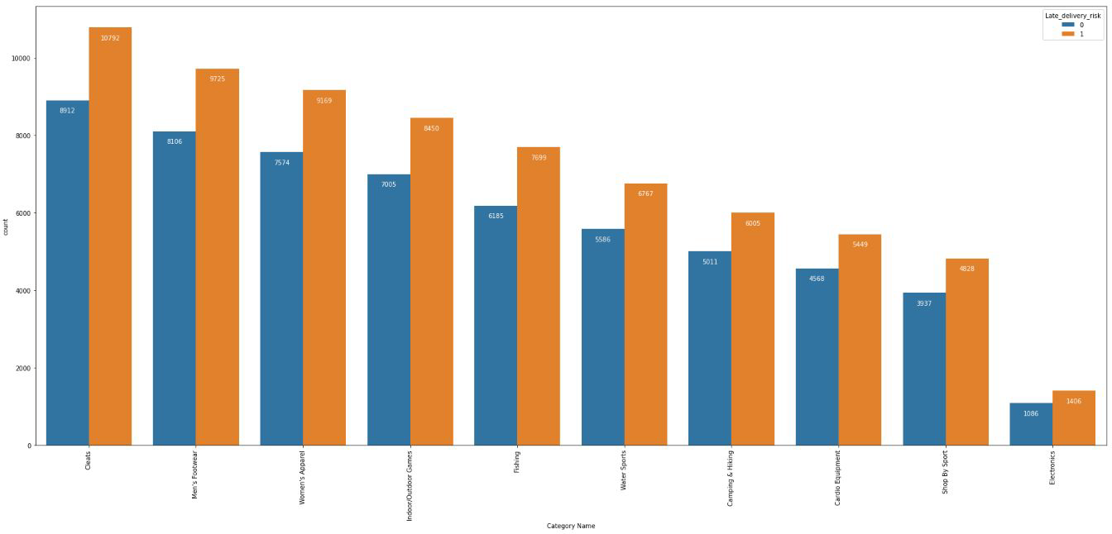
Category needs more deep analysis.
The Category didn’t seems very clear about determining late delivery risk. However, we know that some of category have different category movement. As we can see the more order for speciﬁc category is also more late delivery risk will show up.

Slide 7
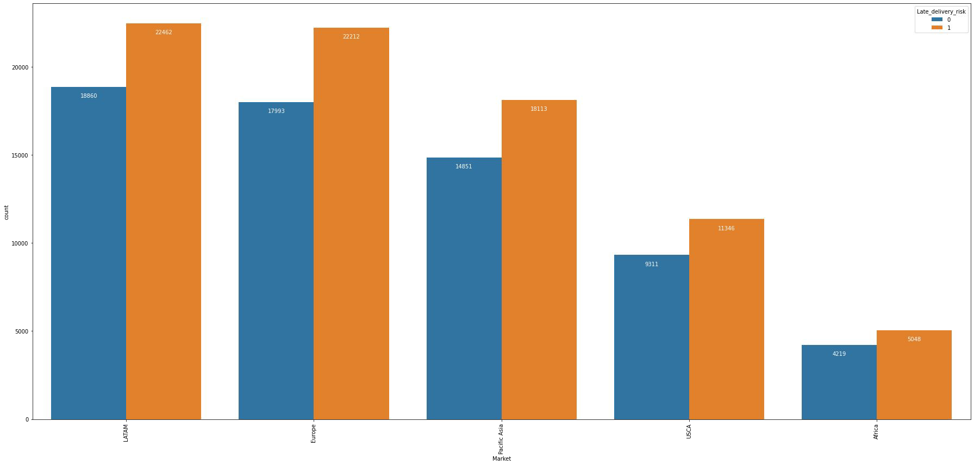
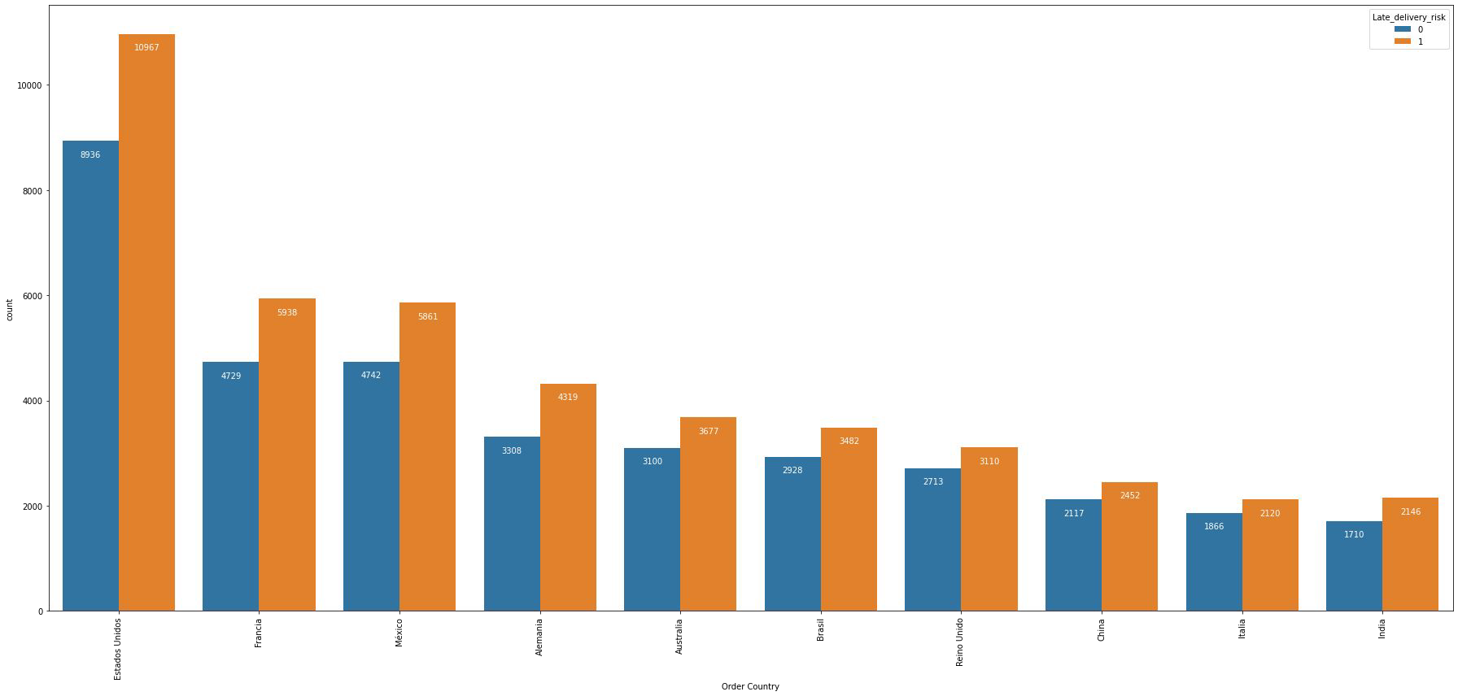
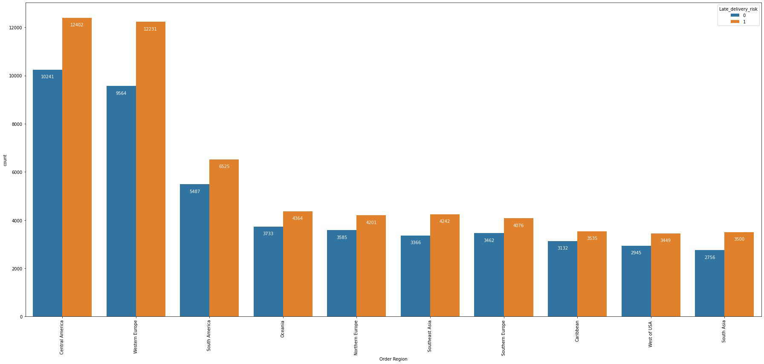
The distance is not really a problem.
As we can see, there is no clear evidence that the late delivery is because of the distance between fulﬁllment center and the customers. However, we need further analysis is there any factors except distance that really make raise late delivery risk.

Slide 8
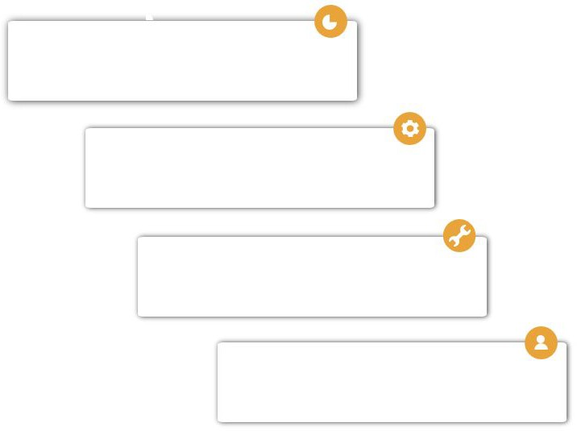
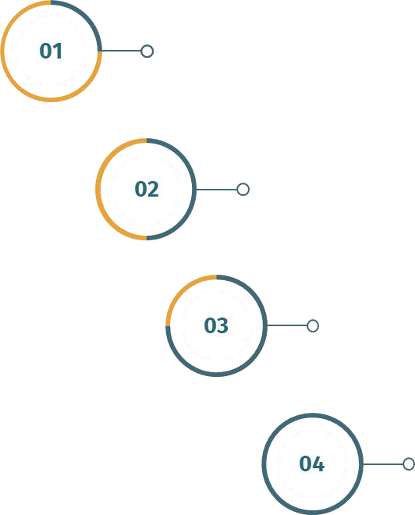
Anomalies Handling, we eliminate the null values for 21 rows & duplicated values 7.908 rows.
Feature Selection, we drop the Order Id column since it’s only contain unique for every rows.
Encoding, we replace the high cardinality category columns with frequency encoding and binary columns with dummy encoding.
Lets Engineering our dataset!
As we can observe from dataset so far, there is column like Order Quantity. For these, we using normalization in order to generalize all value into 0 ~ 1.

Slide 9
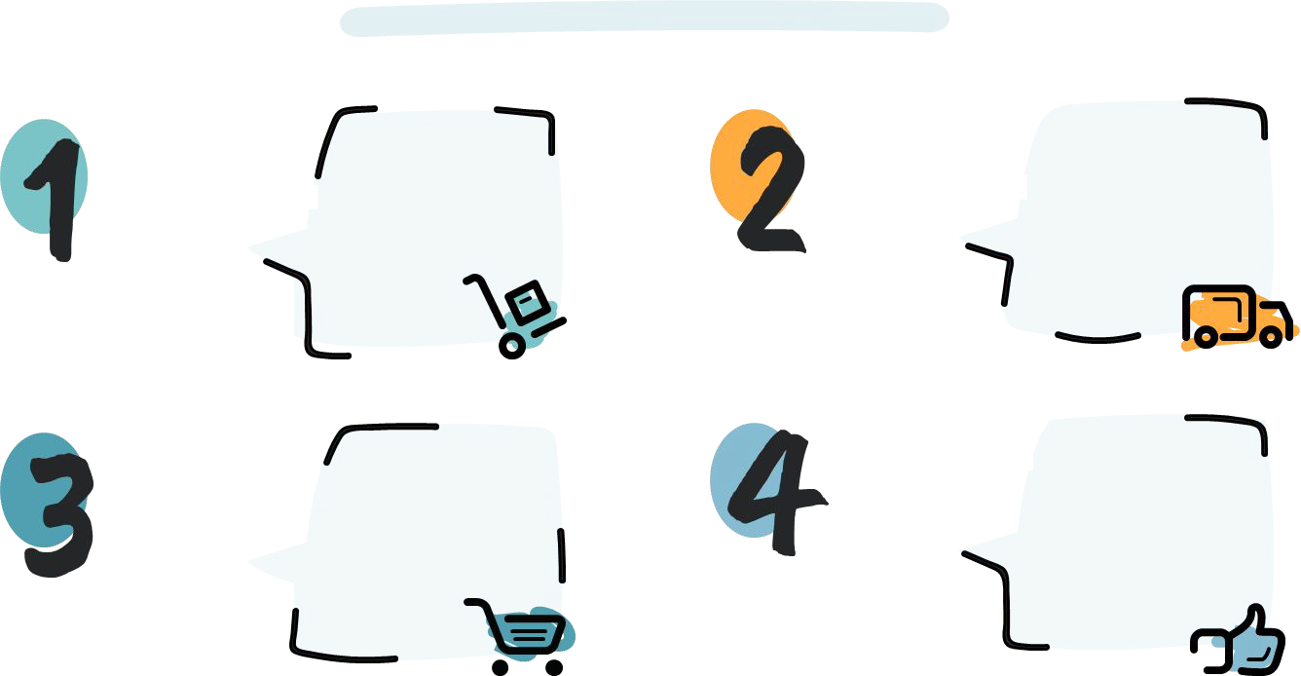
Choosing best model.
F1 Score 0.6644
F1 Score 0.6803
Decision Tree
KNN
F1 Score 0.6633
Random Forest
F1 Score 0.6878
XGB
As we can see, the best model that best suit for our data set is Random Forest in terms of F1-Score.

Slide 10
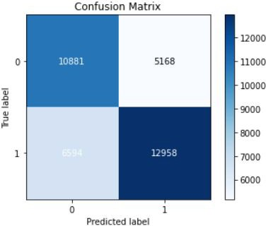
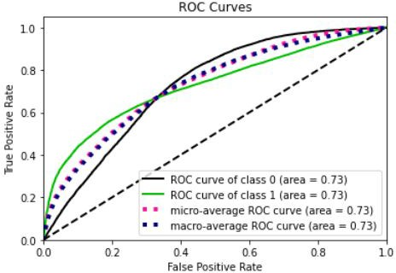
Let’s see how our model perform.
The confusion matrix show :
The model predicted delivery will be late and actually late is 12958. (True Positive)
The model predicted delivery will not late and actually late is 6394. (False Negative)
The model predicted delivery will late and actually not is 5168. (False Positive)
The model predicted delivery will not late and actually not late is 10881. (True Negative)
ROC Curvers show that our model success rate in distinct True Positive and True Negative is 73%. With the F1-Score (the harmony between precision and recall) is 68.7%.

Slide 11
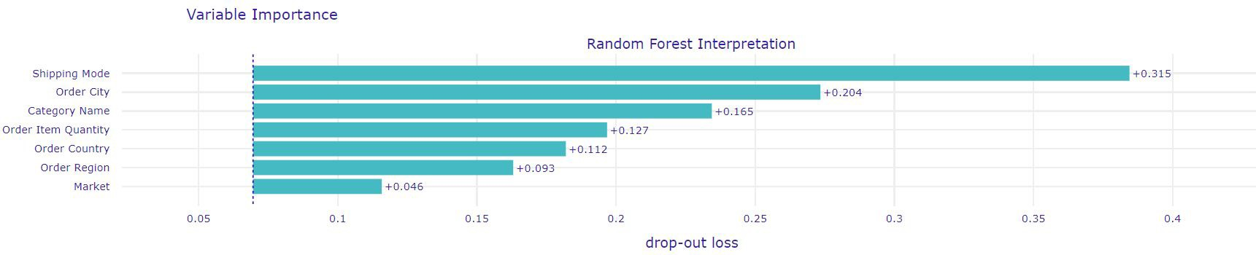
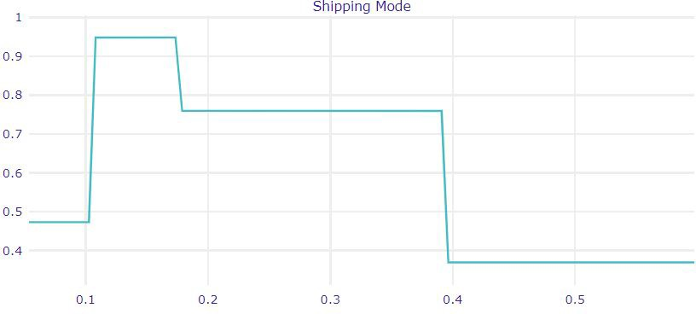
Now let’s talk with our machine learning model.
From the feature importance, we know that the highest four importance variable that help our model to determine late delivery risk is :
Shipping Mode
Order City
Category Name
Order Item Quantity
All of the following result really make sense. However, we also noticed that Order Item Quantity is also determine late delivery risk in which we didn’t found on ﬁrst EDA. We need to do more analysis for this point.
From the partial dependence plot, we know that even there are many factor that impact late delivery, the higher effect comes from shipping mode. We know that if the more shipping mode get used by the company, the higher chance that the delivery will be on time.

Slide 12

Last but not least, improvement step!
From the EDA and maching learning modelling, can formulate recommendation like :
Check the possibility of closing few of Shipping mode. We found that the Standard Class have best performance amongst all, so we can recommend this shipping mode for customer. We can also opening partnership with third-party courier with more sorting hub since we know where the potential orders comes from.
Doing more analysis for characteristic of the customer city. From the modelling we know that city more important than country and region in terms of predicting late delivery risk. Therefore, there is possibility that the distance is not so important. How about the road condition? Weather climate? or anything else that can determine late delivery risk on potential city.
Initiate movement grouping for all Category. From the modelling we know that Category is also have higher importance in determine SLA. Therefore, we can make movement grouping to FAST, MED, and SLOW movement for the Category that company handle. So we can prepare the more effective layout for outbound staging to minimize the lead time for order processing.
Calculate manpower more efﬁciently. As we can see, the order quantity is also one of important feature. The company can calculate several point and analyze the possibility where the most needed for additional manpower. Also we can add the facility to maximize the productivity like conveyor belt so the picker could deliver the goods to packing station without actually walking there.

Slide 13



Let’s connect to discuss!
Full Python Code

